Slide 1
Session 16: Ad. Concepts of Threading Module 3.2: Core Java

Slide 2
Learning Objectives
At the end of the session successful participants will be able to
Implement Thread scheduling
Implement wait() and notify() methods
Implement Synchronization with Producer, Consumer example

Slide 3
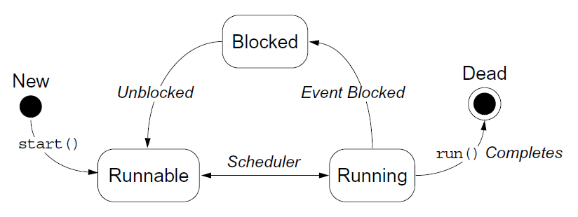
Thread Scheduling
3
Notes:
Instructor Notes:
<<lesson Overview>>.

Slide 4
Thread Scheduling Example
1 public class Runner implements Runnable {
2 public void run() {
3 while (true) {
4 // do lots of interesting stuff
5 // ...
6 // Give other threads a chance
7 try {
8 Thread.sleep(10);
9 } catch (InterruptedException e) {
10 // This thread’s sleep was interrupted
11 // by another thread
12 }
13 }
14 }
15 }
4
Notes:
Instructor Notes:
<<Key Word>>: <<Definition>>

Slide 5
Terminating a Thread
1 public class Runner implements Runnable {
2 private boolean timeToQuit=false;
3
4 public void run() {
5 while ( ! timeToQuit ) {
6 // continue doing work
7 }
8 // clean up before run() ends
9 }
10
11 public void stopRunning() {
12 timeToQuit=true;
13 }
14 }
5
Notes:
Instructor Notes:
<<Key Word>>: <<Definition>>

Slide 6
Terminating a Thread
1 public class ThreadController {
2 private Runner r = new Runner();
3 private Thread t = new Thread(r);
4
5 public void startThread() {
6 t.start();
7 }
8
9 public void stopThread() {
10 // use specific instance of Runner
11 r.stopRunning();
12 }
13 }
6
Notes:
Instructor Notes:
<<Key Word>>: <<Definition>>

Slide 7
Basic Control of Threads
Test threads:
isAlive()
Access thread priority:
getPriority()
setPriority()
Put threads on hold:
Thread.sleep() // static method
join()
Thread.yield() // static method
7
Notes:
Instructor Notes:
<<Key Word>>: <<Definition>>

Slide 8
The join Method
1 public static void main(String[] args) {
2 Thread t = new Thread(new Runner());
3 t.start();
4 ...
5 // Do stuff in parallel with the other thread for a while
6 ...
7 // Wait here for the other thread to finish
8 try {
9 t.join();
10 } catch (InterruptedException e) {
11 // the other thread came back early
12 }
13 ...
14 // Now continue in this thread
15 ...
16 }
8
Notes:
Instructor Notes:
<<Key Word>>: <<Definition>>

Slide 9
Other Ways to Create Threads
1 public class MyThread extends Thread {
2 public void run() {
3 while ( true ) {
4 // do lots of interesting stuff
5 try {
6 Thread.sleep(100);
7 } catch (InterruptedException e) {
8 // sleep interrupted
9 }
10 }
11 }
12
13 public static void main(String args[]) {
14 Thread t = new MyThread();
15 t.start();
16 }
17 }

Slide 10
Selecting a Way to Create Threads
Implement Runnable:
Better object-oriented design
Single inheritance
Consistency
Extend Thread:
Simpler code

Slide 11
Using the Synchronized Keyword
1 public class MyStack {
2
3 int idx = 0;
4 char [] data = new char[6];
5
6 public void push(char c) {
7 data[idx] = c;
8 idx++;
9 }
10
11 public char pop() {
12 idx--;
13 return data[idx];
14 }
15 }

Slide 12
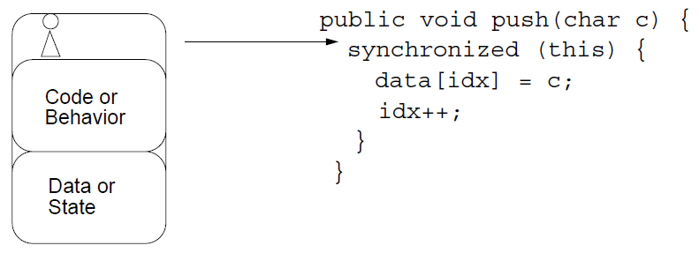
The Object Lock Flag
Every object has a flag that is a type of lock flag.
The synchronized enables interaction with the lock flag.
Object this
Thread before synchronized(this)

Slide 13
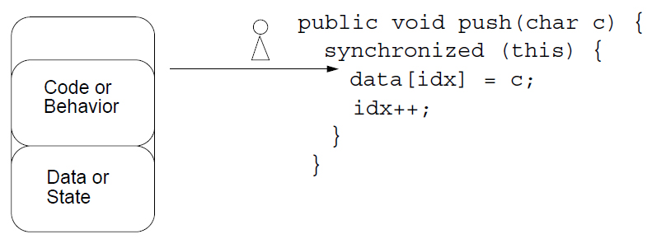
The Object Lock Flag
Object this
Thread after synchronized(this)

Slide 14
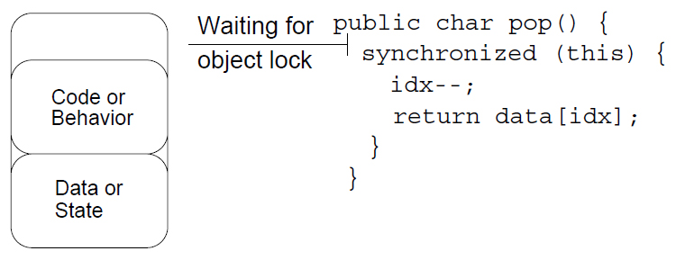
The Object Lock Flag
Object this
lock flag missing
Another thread, trying to
execute synchronized(this)

Slide 15
Releasing the Lock Flag
The lock flag is released in the following events:
Released when the thread passes the end of the synchronized code block
Released automatically when a break, return, or exception is thrown by the synchronized code block

Slide 16
Using synchronized – Putting It Together
All access to delicate data should be synchronized.
Delicate data protected by synchronized should be private.

Slide 17
Using synchronized – Putting It Together
The following two code segments are equivalent:
public void push(char c) {
synchronized(this) {
// The push method code
}
}
public synchronized void push(char c) {
// The push method code
}

Slide 18
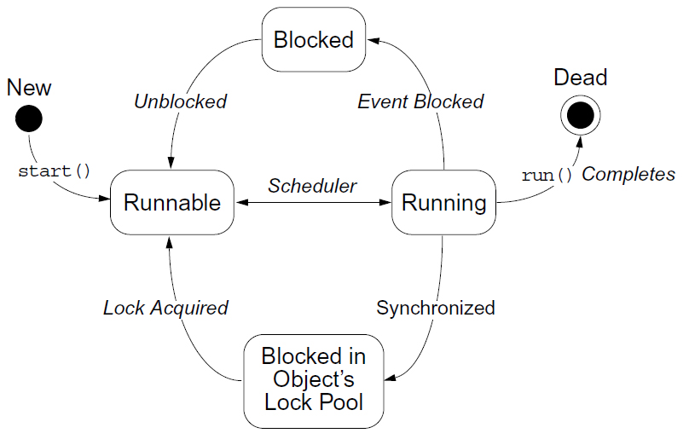
Thread State Diagram With

Slide 19
Deadlock
A deadlock has the following characteristics:
It is two threads, each waiting for a lock from the other.
It is not detected or avoided.
Deadlock can be avoided by:
Deciding on the order to obtain locks
Adhering to this order throughout
Releasing locks in reverse order

Slide 20
Thread Interaction – wait and notify
Scenario:
Consider yourself and a cab driver as two threads.
The problem:
How do you determine when you are at your destination?
The solution:
You notify the cab driver of your destination and relax.
The driver drives and notifies you upon arrival at your destination.

Slide 21
Thread Interaction
Thread interactions include:
The wait and notify methods
The pools:
Wait pool
Lock pool

Slide 22
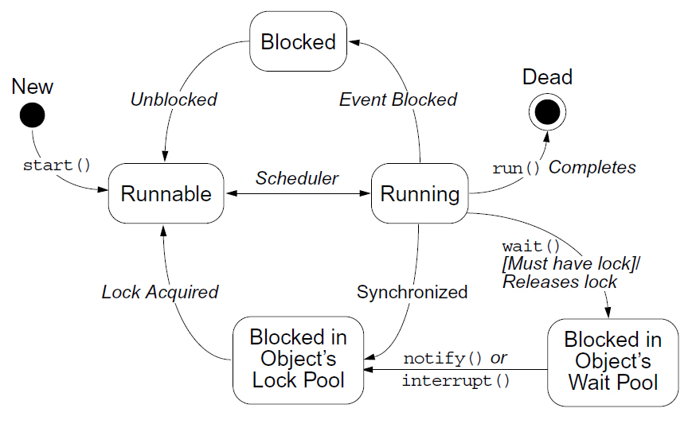
Thread State Diagram With

Slide 23
Monitor Model for Synchronization
Leave shared data in a consistent state.
Ensure programs cannot deadlock.
Do not put threads expecting different notifications in the same wait pool.

Slide 24
The Producer Class
1 package mypack;
2
3 public class Producer implements Runnable {
4 private SyncStack theStack;
5 private int num;
6 private static int counter = 1;
7
8 public Producer (SyncStack s) {
9 theStack = s;
10 num = counter++;
11 }
12

Slide 25
The Producer Class
13 public void run() {
14 char c;
15
16 for (int i = 0; i < 200; i++) {
17 c = (char)(Math.random() * 26 +’A’);
18 theStack.push(c);
19 System.out.println(“Producer” + num + “: “ + c);
20 try {
21 Thread.sleep((int)(Math.random() * 300));
22 } catch (InterruptedException e) {
23 // ignore it
24 }
25 }
26 } // END run method
27
28 } // END Producer class

Slide 26
The Consumer Class
1 package mod13;
2
3 public class Consumer implements Runnable {
4 private SyncStack theStack;
5 private int num;
6 private static int counter = 1;
7
8 public Consumer (SyncStack s) {
9 theStack = s;
10 num = counter++;
11 }
12

Slide 27
The Consumer Class
13 public void run() {
14 char c;
15 for (int i = 0; i < 200; i++) {
16 c = theStack.pop();
17 System.out.println(“Consumer” + num + “: “ + c);
18
19 try {
20 Thread.sleep((int)(Math.random() * 300));
21 } catch (InterruptedException e) {
22 // ignore it
23 }
24 }
25 } // END run method
26

Slide 28
The SyncStack Class
This is a sketch of the SyncStack class:
public class SyncStack {
private List<Character> buffer = new ArrayList<Character>(400);
public synchronized char pop() {
// pop code here
}
public synchronized void push(char c) {
// push code here
}
}

Slide 29
The pop Method
9 public synchronized char pop() {
10 char c;
11 while (buffer.size() == 0) {
12 try {
13 this.wait();
14 } catch (InterruptedException e) {
15 // ignore it...
16 }
17 }
18 c = buffer.remove(buffer.size()-1);
19 return c;
20 }
21

Slide 30
The push Method
22 public synchronized void push(char c) {
23 this.notify();
24 buffer.add(c);
25 }

Slide 31
The SyncTest Class
1 package mypack;
2 public class SyncTest {
3 public static void main(String[] args) {
4 SyncStack stack = new SyncStack();
5 Producer p1 = new Producer(stack);
6 Thread prodT1 = new Thread (p1);
7 prodT1.start();
8 Producer p2 = new Producer(stack);
9 Thread prodT2 = new Thread (p2);
10 prodT2.start();
11
12 Consumer c1 = new Consumer(stack);
13 Thread consT1 = new Thread (c1);
14 consT1.start();
15 Consumer c2 = new Consumer(stack);
16 Thread consT2 = new Thread (c2);
17 consT2.start();
18 }
19 }

